Slide 1

AI-Powered Retirement Planning
Advisor
Dr. Beomjin Kim
Notes:
AJINKYA

Slide 2



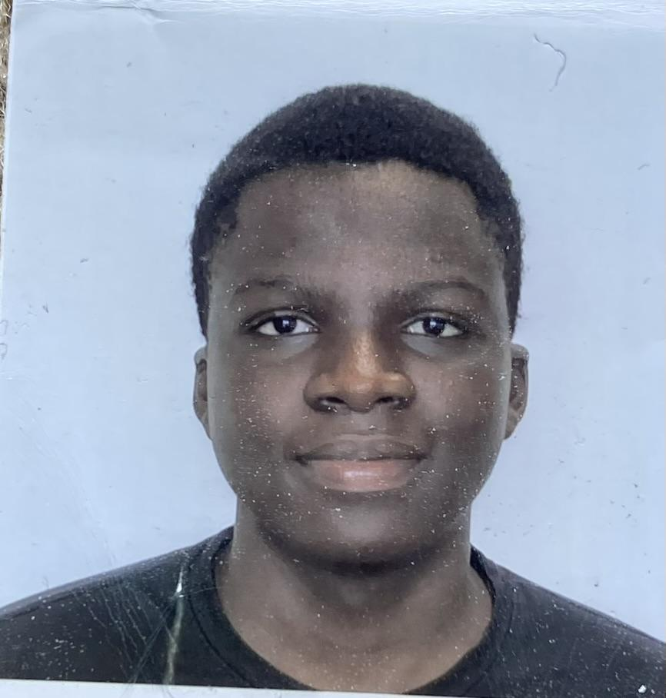


Team Profile
Ajinkya Abhijit Naik
Anthony Blaze Jackson
Damilola Williams
Gareth Noble
Gustavo P. C. da Silva
Team Lead
RAG Technician
Project Manager
AI Pipeline
Backend Engineer
LLM Integration
Frontend Engineer
UI/UX Specialist
Backend Engineer
Prompt Engineering
Notes:
AJINKYA

Slide 3
01 | The Problem? Our Change?
02 | Project Overview
03 | Requirements
04 | Stretch Goals
05 | Technology Stack
06 | Timeline
07 | Challenges
08 | Final Product and Value
Table of Contents
Notes:
AJINKYA

Slide 4

The Problem? Our Change?
Only 21 percent of adults surveyed in EBRI’s 2024 Retirement Confidence Survey (RCS) said they felt “very confident” that they would have enough money in retirement
Low retirement confidence
Fragmented tools
Low literacy and Outdated advice
Complex Laws and Rules
What we’ll build:
An Agentic-AI system that will improve confidence and educate the masses.
Notes:
BLAZE

Slide 5

Project Overview
Core Idea:
Retirement planning is often complex, fragmented, and hard for individuals to understand.
Project aims to simplify retirement planning through a guided, personalized system.
Project will focus on a full integrated system which can collect user details, apply trusted rules, and generate clear, tailored retirement plans.
Notes:
BLAZE

Slide 6

Requirements
Guided User Input:
Simple, secure user centric interface for entering details (age, savings, risk tolerance).
Dynamic Prompt Generation:
Uses prompt engineering to auto create appropriate prompt templates based on how the user interacts with the interface.
Trusted Sources & Retrieval
Uses RAG to pull information from trusted sources to ensure accuracy.
Structured data & Plan output:
Using LLM as foundational model converts inputs into structured data, applies financial rules, explains plan clearly.
Notes:
GARETH

Slide 7

Stretch Goals
Other Retirement Goals
Loan repayment, education savings, emergency fund planning, etc.
Adaptive Market Responses
Generate tailored responses based on simulations across different market conditions.
User Account Management
Enable users to create and manage accounts with personalized profiles, ensuring secure access and tailored planning.
AI supported prompt engineering
Collaborate with a domain expert or financial institution
Notes:
GARETH

Slide 8

Tech Stack & Communication Tools
Foundational LLMs
OpenAI APIs
Ollama, Claude
Fine tuning
RAG
ChromaDB (local) or Qdrant
LangChain (ingest, retriever pipelines).
It can pull information directly from documents, guidelines, and research that don’t always have APIs, while also providing citations for transparency.
Prompt Engineering
Frameworks
React (Frontend)
Python (Backend)
Communication Media
Jira, Discord, Teams and Email.
Notes:
DAMI

Slide 9
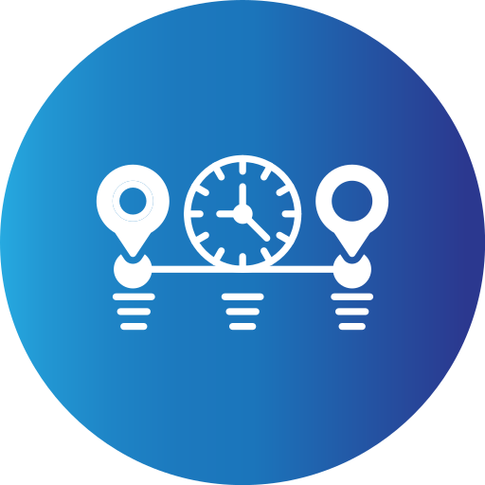
Tentative Timeline
Aug - Sept: Finalizing scope and requirements
Sept - Oct: Finalize end-to-end pipeline
Oct - Jan: Build independent modules: LLM, RAG retriever/indexer, Prompt templates, etc.
Jan - March: Integrate all modules and user-centric, intuitive UI
March - April: Testing and minor bugs fixes
Notes:
GUSTAVO

Slide 10

Challenges We Will Overcome
Data Integration
Building and maintaining a reliable RAG knowledge base (IRS docs, research papers, tax rules)
Data Privacy
Ensuring anonymization before sending prompts to the LLM.
Prompt Engineering
Crafting effective prompt templates for accurate, personalized responses
LLM Hallucination
Ensuring the model does not produce misleading financial advice
User Experience
Presenting complex results in a simple, visual way.
Notes:
GUSTAVO

Slide 11

Final Product & Value
A web-based Agentic AI system with user-centric interface
Collect User details
Structured processing with accurate data, rules and clear explanations.
Well-defined personalized plan and roadmap for retirement.
Notes:
AJINKYA

Slide 12

Retirement confidence should not be a privilege.
Our Mission: Make it accessible to everyone!
Thank You!
Questions?
Notes:
AJINKYA

